Slide 1
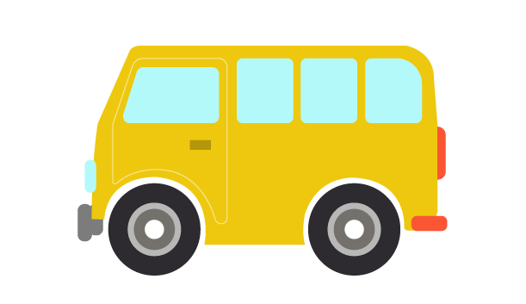
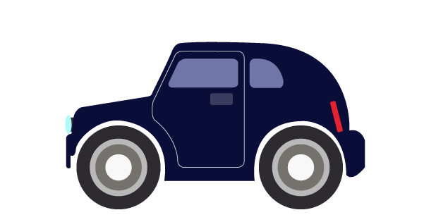
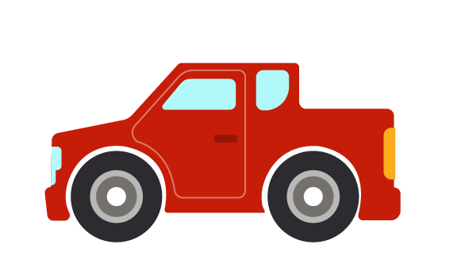
introduction to transportation
Maritime Transportation Research and Education Center
Notes:
(2:30)

Slide 2
Want to answer? Have a question? PLEASE RAISE YOUR HAND.
Notes:
0 min
(2:30)

Slide 3
INTRODUCTIONS
Sarah Hernandez, Ph.D.
Assistant Professor, Department of Civil Engineering
Taslima Akter
Ph.D. Candidate, Department of Civil Engineering
Karla Diaz-Corro
Masters Student, Department of Civil Engineering
Mariah Crews
Undergraduate Student, Department of Civil Engineering
Beth Francis
Undergraduate Student, Freshman Engineering Program
Notes:
2 min – We each introduce ourselves with one fun fact and our specialty
Example: I’m Mariah Crews and I am working on my Bachelors Degree in Civil Engineering and when I was younger, I used to play a computer game called Roller Coaster Tycoon and build an entire theme park in the game. When I grow up, I hope to design transportation systems and roadways.
(2:32)

Slide 4
WHEN YOU GO TO THE MOVIES, HOW DO YOU GET THERE?
Notes:
1 min – Ask this questions and follow-up questions as needed that will make students think about transportation infrastructure on a large scale:
When you go to the movies, how do you get there?
What if there were no roads?
What if there were no sidewalks to walk or bike?
Etc.
(2:33)

Slide 5
WHAT’S YOUR FAVORITE COLOR?
Notes:
0 min – Ask this question and let each student tell you their favorite color; Make a tally on the board for each one that likes blue, green, etc.
(2:33)

Slide 6
When other people see it,
what does your favorite color make them think of?
Notes:
1 min – Pick out a few students to tell you what their color might make other people think of
(2:34)

Slide 7
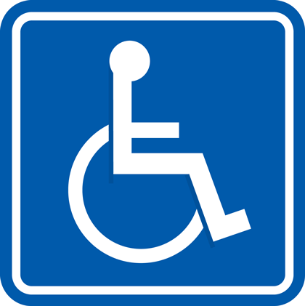
COLORS IN TRANSPORTATION
Colors are used in transportation as a communication tool.
RED: Stop
YELLOW: Slow / Yield
GREEN: Go!
BLUE: ???
ORANGE: ???
WHITE: ???
Notes:
2 min -- Introduce the basic traffic stop colors to the students and explain how they communicate to drivers on the road.
Ask them what blue might signal to drivers on the road. Good Answers: Handicap Accessibility, General Information for food/gas, Hospital
Ask them what orange might signal to drivers on the road. Good Answers: Construction, Detour
(2:36)

Slide 8
EVEN THE COLOR OF THE LINES ON THE ROAD HAVE MEANING
Yellow – Traffic on the other side of this line is travelling the opposite direction
White – Edge of your lane; If there are multiple lanes with white lines, traffic on either side of the white lines will be travelling in the same direction
Notes:
1 min – Explain what yellow and white lines mean on the road
(2:37)

Slide 9
V O C A B U L A R Y
Traffic lights operate in phases and are indicated by colors. (They sometimes include arrows, too.)
The timing of these traffic lights refers to the amount of time (usually in seconds) that is dedicated to each phase.
Notes:
2 min – Present information and allow time for students to record terms in their packet
(2:39)

Slide 10
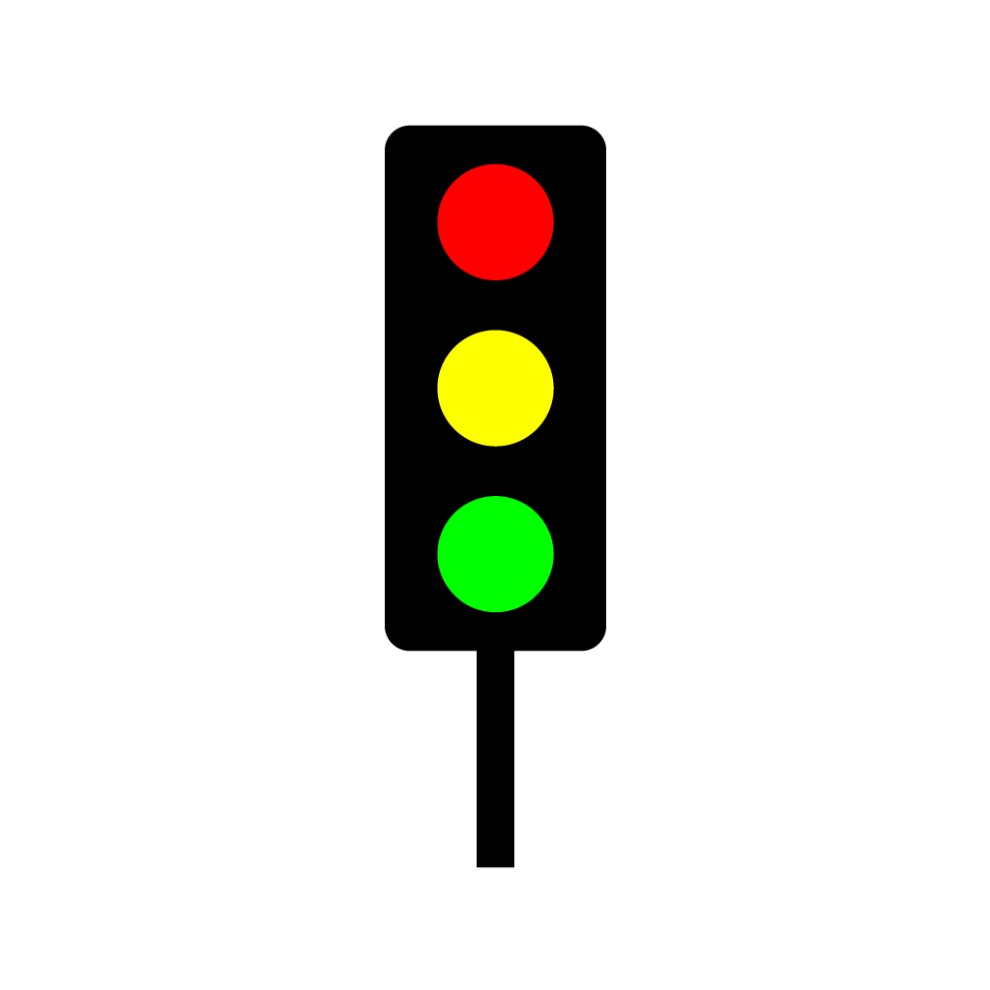
WHEN WE’RE STUCK AT A RED LIGHT
and we have somewhere important to be…
How do we feel?
What are we thinking?
Should other people at the intersection get to go first?
Who is most important at the intersection?
…and why?
Notes:
2 min – Let the students explore these questions and how drivers might feel when they have somewhere important to be. Let them try to guess who the most important people are on the road.
These are meant to be rhetorical questions to get them thinking beyond the self.
(2:41)

Slide 11
WHILE IT MAY BE FRUSTRATING…
our first priority as transportation engineers is SAFETY.
SAFETY includes making our intersections
Consistent
Predictable
Efficient
Notes:
1 min – Present information and let the students record term in packet
(2:42)

Slide 12
BUT WE ALSO DON’T WANT PEOPLE WAITING UNNECESSARILY
When people are stopped at a red light, it causes what is referred to as a delay.
The time it takes for the light to complete both the red and green phases is called a cycle.
Notes:
2 min – Present information and let students record terms in packet
(2:44)

Slide 13
What happens if we have a really long cycle?
What happens if we have a really short cycle?
Notes:
0 min – Ask students for their ideas on these two questions; Animations will cause them to appear one at a time.
(2:44)

Slide 14
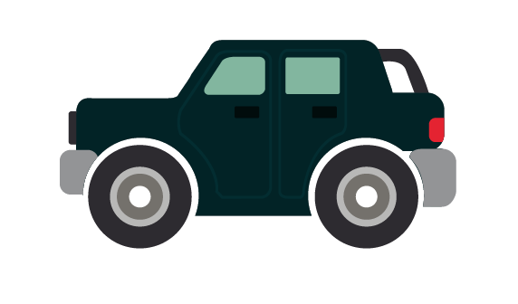
IF THE LIGHT STAYS RED FOR A LONG TIME, CARS BEGIN TO FORM A LINE.
This is referred to as a queue.
Notes:
1 min – present information and allow students to record terms in packet
(2:45)

Slide 15
E F F I C I E N C Y
Efficiency refers to the ability of the traffic signal timing
to minimize the queue.
If both traffic lights have the same amount of cars traveling down their road, which traffic light’s timing must be more efficient?
1 or 2?
1
2
Notes:
2 min – Ask the students to raise their hand if they know what it means to be efficient. If so, choose a student to define it in their own words. Then present our definition of efficiency.
Call on one student to answer the question and then ask the room if they agree. Allow time for students to draw the queues in their packets.
(2:47)

Slide 16
Y O U R T U R N
Notes:
1 min – Introduce Transit Trouble game and give a brief overview of the goals/concepts
(2:48)

Slide 17
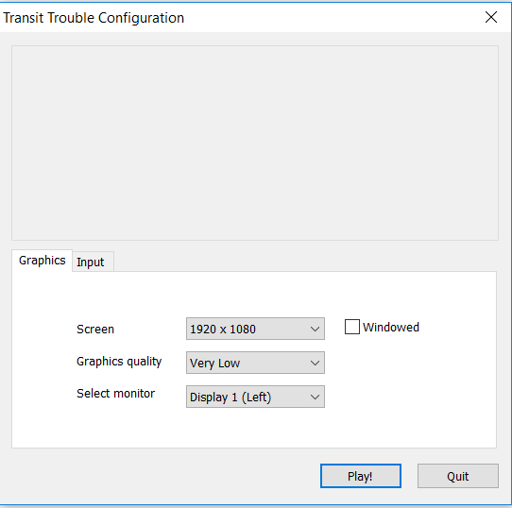
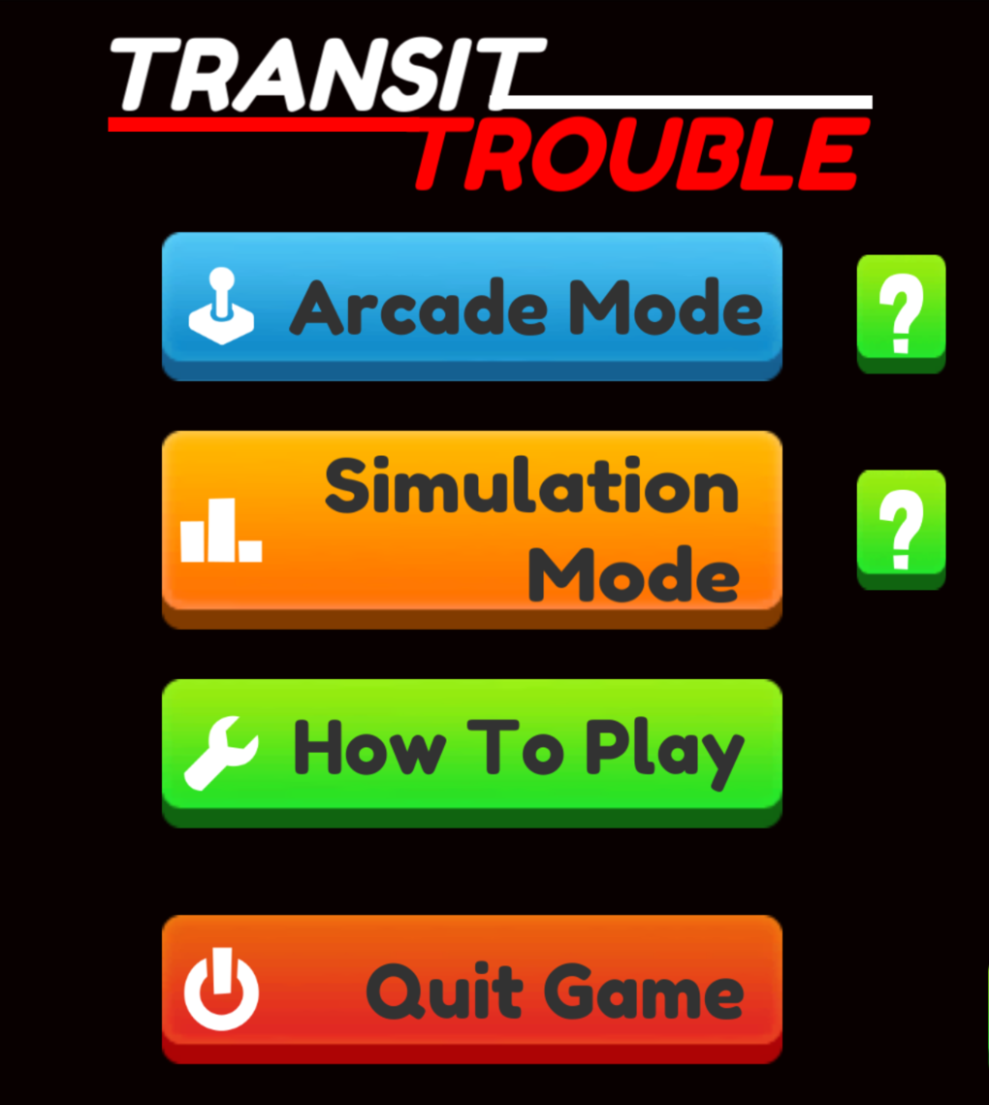
ON YOUR DESKTOP
1. Click on the Transit Trouble game
2. Click on Play!
3. Choose Arcade Mode
Notes:
1 min – Show the students how to open the Transit Trouble files and play in Arcade Mode
(2:49)

Slide 18
H O W T O P L A Y
Notes:
2 min – Explain the frustration meter, timer, the traffic lights, how to get help, and view the street from different vantage points
(2:51)

Slide 19
FIRST ONE TO
COMPLETE
LEVEL 4
GETS A PRIZE!
Notes:
10 min – Leave this on the screen until someone has received the prize (hardhat & sunglasses). Instruct everyone to STOP at the end of Level 4.
(3:01)

Slide 20
MANUAL TRAFFIC CONTROL
Levels 1-4 involve manual traffic control, meaning that an individual is changing the traffic signals as they observe the traffic’s behavior and based on its current needs.
Can you think of a time that you have seen manual traffic control?
*Hint: Stoplights don’t normally operate this way, but people do.
Notes:
2 min – Present information and allow time for students to match terms to definitions in their packet; Have a few students answer the question (offer hints as necessary); Good Answers: After a concert, After a Razorback football game, etc.
(3:03)

Slide 21
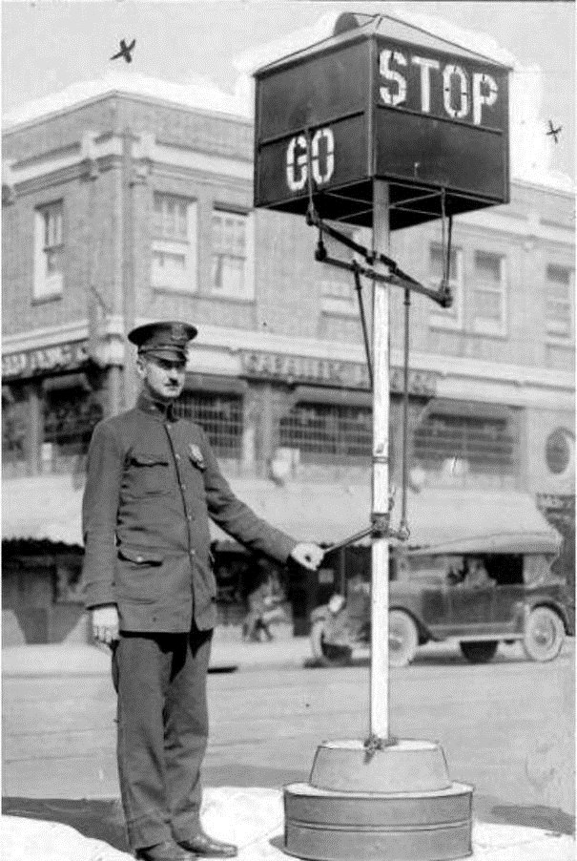
Notes:
0 min
(3:03)

Slide 22
FIXED-TIME CONTROL
Levels 5+ involve fixed-time control, which means that the phases of stoplights last the same amount of time every time and are pre-set. These phase times are based off of historical data.
If done correctly, fixed-time control can be a more efficient method than manual traffic control.
Let’s give it a try!
Notes:
2 min – Present information and allow time for students to match terms to definitions in packet
(3:05)

Slide 23
NEW OPTIONS IN THE BOTTOM LEFT CORNER
Notes:
1 min – Introduce the new parts of Transit Trouble for Levels 5+ including how to manually set the time and how to adjust different intersections
(3:06)

Slide 24
WHO COMPLETED ALL THE
STAGES THE QUICKEST?
WHO HAD THE LEAST AMOUNT OF
FRUSTRATION ON THEIR METER?
WHO SUCCESSFULLY
COMPLETED ALL EIGHT STAGES?
Notes:
10 min – Converse with the girls about how there are different kinds of measures of success in the game and in real life; We might be looking for high scores, efficiency, the least amount of frustration, or some combination of it all that completes the task at hand.
(3:16)

Slide 25
ACTUATED SIGNAL CONTROL
Actuated signal control uses sensors to detect cars (like a giant metal detector), which changes the traffic lights to avoid delays.
This technology is complex and expensive, but is the most efficient method by which traffic is controlled today.
Notes:
2 min – Present information and allow time for students to match the terms to the definitions in their packet
BACK TO PACKET FOR POP QUIZ!!!
(3:18)

Slide 26
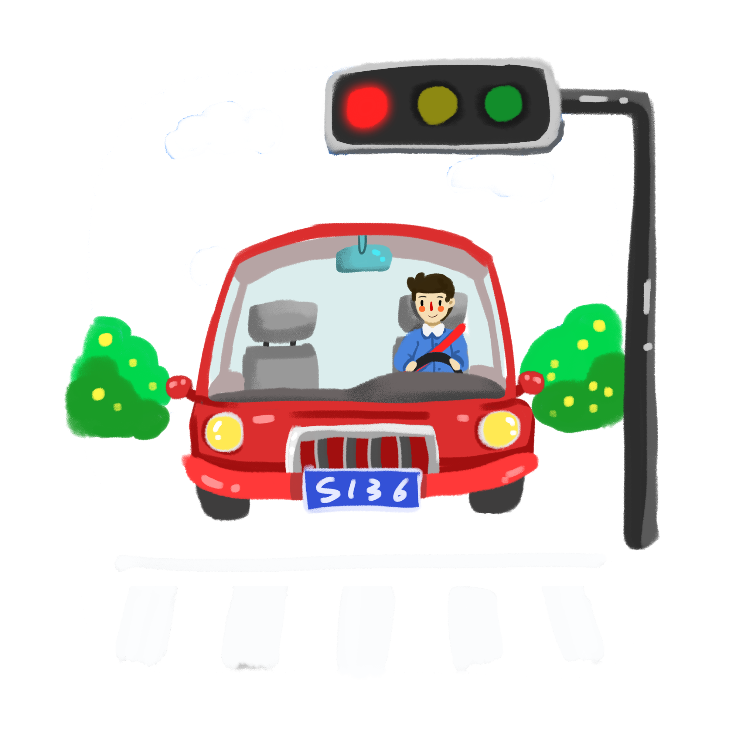
SAM IS THE ONLY ONE AT THIS LIGHT
THIS IS SAM
Notes:
1 min – Introduce Sam and explain that he is the only one at this intersection – there are no cars behind him or around him.
Explain how actuated signal control will automatically detect Sam’s car and change the light from red to green for him.
(3:19)

Slide 27
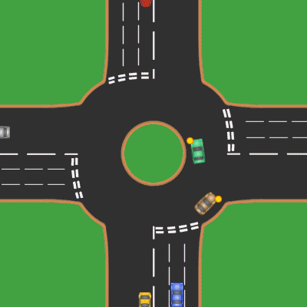
TO THE CVEG LOUNGE!
OVERVIEW:
Live Simulation with Manual Signal Timing
Live Simulation with Fixed-Time Control
Introduction of Roundabouts
YOU WILL NEED:
Your packet
Your pencil
Your personal belongings
The traffic route assignment taped to the bottom of your chair
Notes:
6 min -- Transition to the CVEG Lounge // Instruct them to sit in their groups
(3:25)
Keep these notes for conversation in the CVEG lounge:
BENEFITS OF ROUNDABOUTS DISCUSSION:
Traffic from all directions can continue travelling in all directions, just like a standard four-way
Roundabouts significantly minimize delay when properly placed; Cars rarely have to stop for long periods of time
Roundabouts, while still prone to collisions, minimize serious collisions because they are rear-end collisions (rather than T-bone) etc.

Slide 28
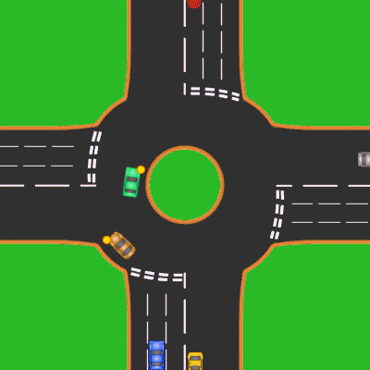
FOUR-WAY INTERSECTIONS
Notes:
PRINT AS POSTER

Slide 29
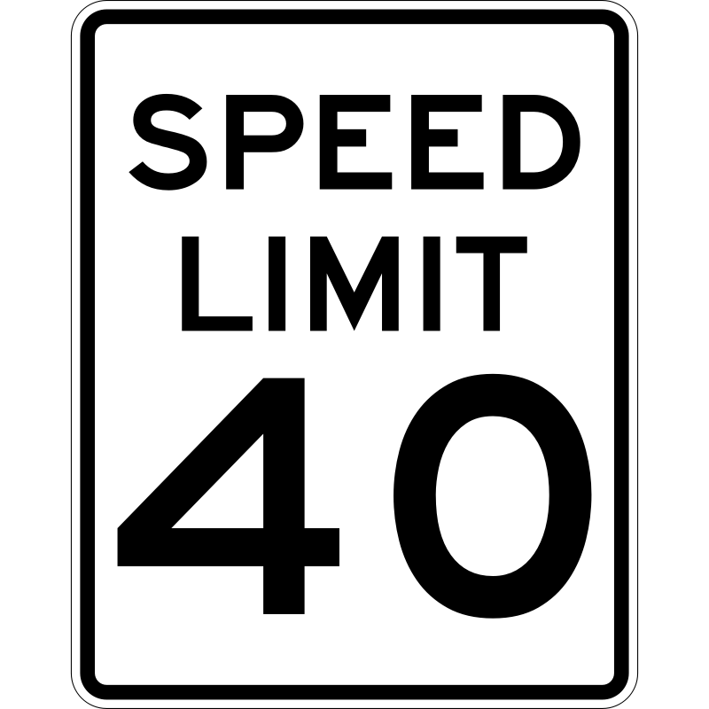
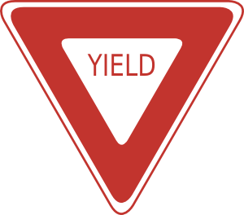
UNDER CONSTRUCTION
STREET SIGN KEY:
LINE KEY:
Cars may not switch lanes
Cars may switch lanes
Cars may not enter this side of traffic
There is a traffic signal ahead
The upcoming intersection is a roundabout
Drivers may not drive faster this speed
Cars are not required to stop but need to be aware of others and the right-of-way
Cars must come to a
complete stop
Notes:
PRINT AS POSTER

